Slide 1



Azure
.NET on Azure
Various options to run your legacy .NET Apps and Cloud native apps on Azure
Maheshkumar R
Cloud Solution Architect, Microsoft
maheskblr
Notes:
Hello everyone!
Thanks for joining and giving us an opportunity to discuss how Azure can provide great value to your .NET needs.
If you are a .NET developer or architect who wants to get started with Microsoft Azure, this session is for you!
We are going to talk about the latest on .NET and its ecosystem, roadmap and its future. We will also see how to get started with Azure services you can use to run your .NET applications and also build a cloud native solution on Azure.
Before we dive in, let’s take a moment to catch up with .NET updates to set the context.

Slide 2
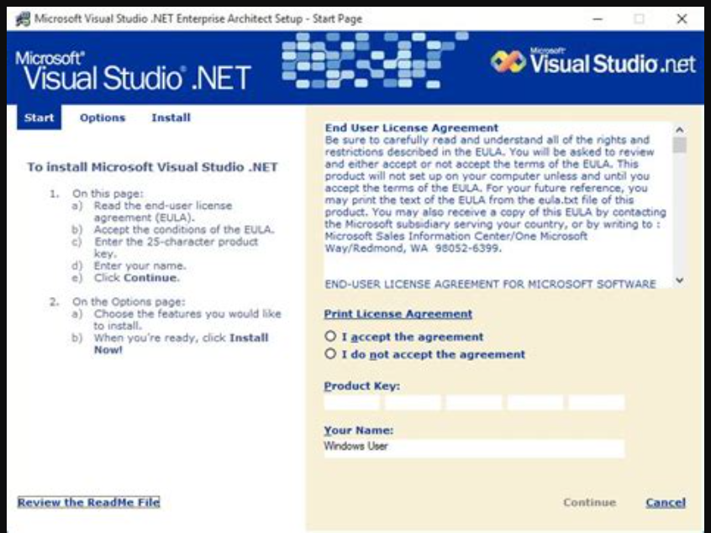
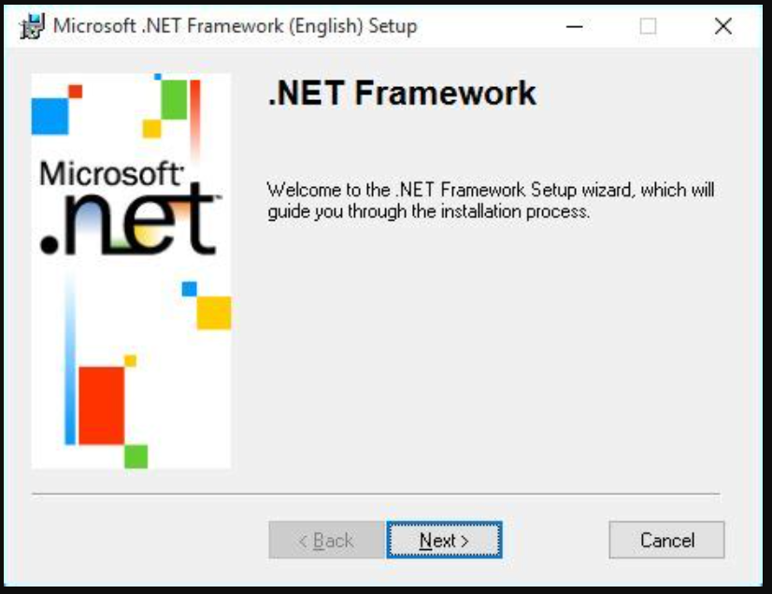
www.dot.net

Slide 3
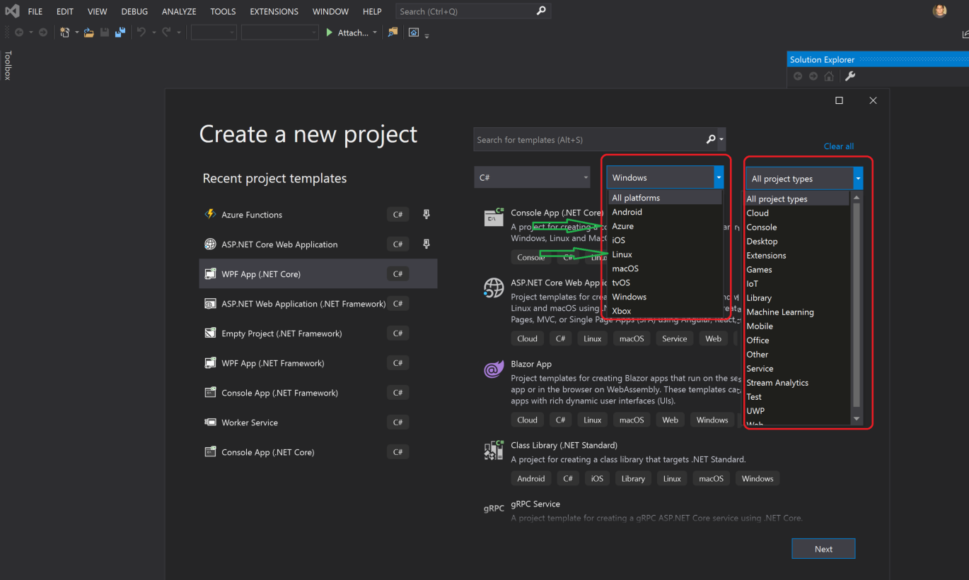
www.dot.net

Slide 4


.NET
Your platform for building anything
Desktop
Web
Cloud
Mobile
Gaming
IoT
AI
Notes:
You can build anything with .NET.
We’ve made significant investments in .NET over the years as well as unifying the ecosystem to support building literally anything. From desktop to gaming to the cloud, .NET is a general purpose programming platform that enables all kinds of application scenarios. Once you learn one, you can easily pick up another.

Slide 5
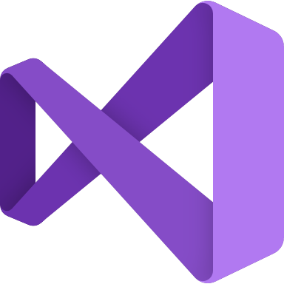



.NET – A unified platform
TOOLS
DESKTOP
WEB
CLOUD
MOBILE
GAMING
IoT
AI
VISUAL STUDIO
VISUAL STUDIO FOR MAC
.NET STANDARD
LIBRARIES
VISUAL STUDIO CODE
INFRASTRUCTURE
CLI
RUNTIME COMPONENTS
COMPILERS
LANGUAGES

Slide 6
.NET Standard– A unified platform
TOOLS
DESKTOP
WEB
CLOUD
MOBILE
GAMING
IoT
AI
WPF
Windows Forms
UWP
ASP.NET
Azure
Xamarin
Unity
ARM32
ARM64
ML.NET
.NET for Apache Spark
VISUAL STUDIO
VISUAL STUDIO FOR MAC
.NET STANDARD
LIBRARIES
VISUAL STUDIO CODE
INFRASTRUCTURE
CLI
RUNTIME COMPONENTS
COMPILERS
LANGUAGES
Notes:
.NET Standard brings it all together
.NET Standard provides a specification for all .NET platforms to implement in order to share code & binaries between all workloads.

Slide 7
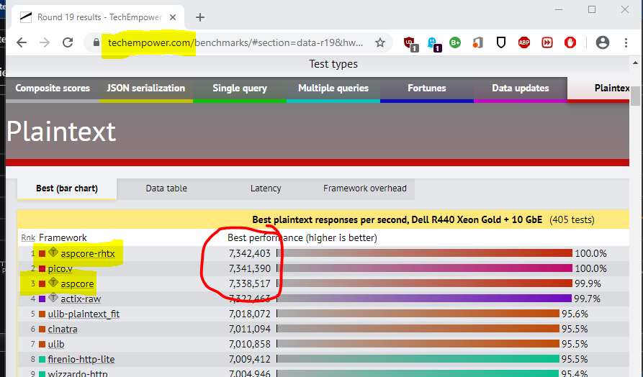




.NET ecosystem momentum
>1M .NET Core developers
#1 Most Loved
Framework
Top 30
Highest velocity OSS projects
.NET Core
github.com/dotnet github.com/aspnet
in Visual Studio
Top 5
Language on GitHub
7x
Faster than Node.js
40%
New to .NET are students
C#
ASP.NET Core
dot.net download survey
Notes:
https://insights.stackoverflow.com/survey/2019#most-loved-dreaded-and-wanted
https://github.com/cncf/velocity/
https://octoverse.github.com/
https://www.techempower.com/benchmarks/#section=data-r18&hw=ph&test=plaintext

Slide 8
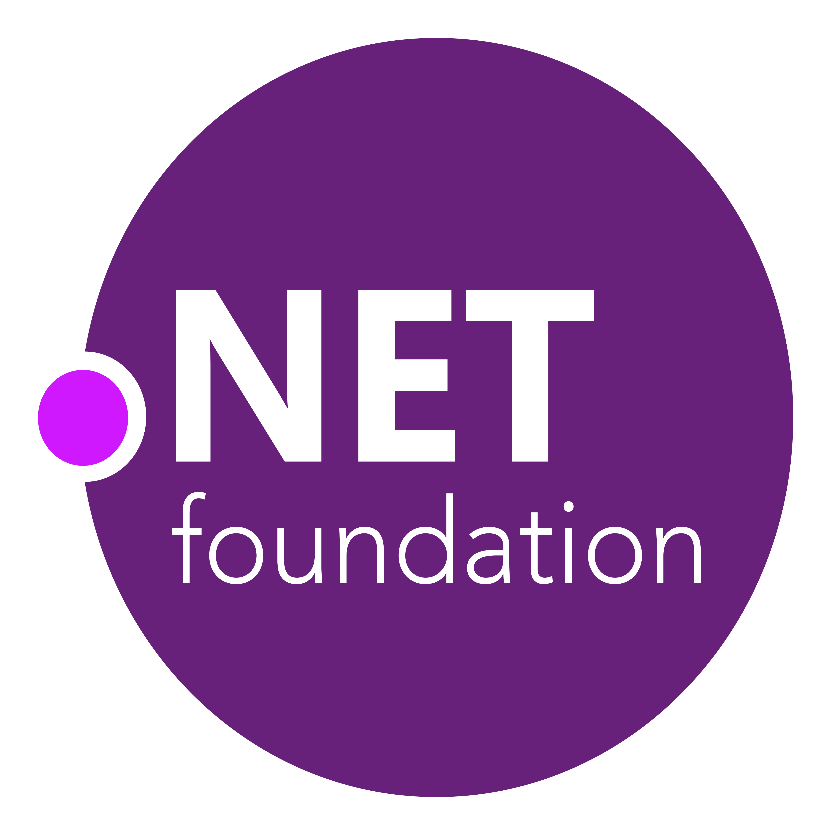

.NET Open Source Journey
.NET
2001
ECMA 335
2008
ASP.NET MVC (web platform) open source
April 2014
.NET Compiler Platform (“Roslyn”) open source
.NET Foundation founded
2016
Mono project joins .NET Foundation
Dec. 2019
.NET Core 3.1
2002
NET 1.0 for Windows released. Mono project begins
Aug. 2017
.NET Core 2.0 released
Nov. 2014
.NET Core (cross-platform) project begins
Dec. 2018
.NET Core 2.2 released WinForms and WPF go open source
Notes:
<talk to the journey, key milestones below>
Dec 2001-Feb 2002.
A new platform is born. Along with HP, Intel and others, the ECMA-335 standard was created that defined a common language infrastructure to support multiple programming languages. C# and Visual Basic.NET were released and F# came later in 2007, but there are over 20 other .NET languages today. Visual Studio .NET was released and included C#, VB, C++ development all in one box. This was the first IDE that was truly integrated across multiple languages.
Mono project begins. The CLI spec gave others the ability to create their own .NET implementations. Even though Microsoft built the first .NET Framework for Windows-only, the spec was intentionally portable across OSes and chipsets. The Mono project began, spearheaded by Miguel de Icaza, with the goal to implement Microsoft's new .NET development platform on Linux and Unix-like platforms. Later, Miguel started Xamarin which focused on cross-platform, native, mobile development with C#, built upon Mono. This allows developers to use C# and .NET to build apps for iOS and Android. Unity games development also emerged from Mono.
2008.
ASP.NET MVC web development stack is released to CodePlex as open source. This was the first application development framework from Microsoft to be released as open source. The underlying runtime and compilers were still closed however.
2014.
Hell freezes over & pigs fly. Early 2014 at Microsoft’s BUILD conference, Anders Hejlsberg, the father of C#, releases the .NET Compiler Platform “Roslyn” as open source on stage. Later in November, .NET Core project begins in the open. The technology world is shocked, and the .NET community is excited. .NET Core is a new cloud-native implementation of .NET that is geared for cross-platform, hyper-scale services as well as small IoT devices. It’s meant to bring .NET into the next 15 years of computing. And the community has been extremely supportive….
2016.
Mono comes home. In early 2016, Microsoft finally acquires Xamarin and brings Miguel de Icaza into Developer Division. Mono joins the .NET foundation and is officially supported and contributed to by Microsoft. The Microsoft community officially meets the Mono community.
2017.
.NET Core 2.0 Released. Our cross platform and open source implementation of .NET finally releases to the world with unified tooling support across multiple operating systems and editors.
2018.
Winforms and WPF go open source. At Microsoft Connect 2018 we announced the open sourcing of Windows Forms and WPF desktop frameworks. We’ve seen incredible contributions and activity since. The community now has the power to guide the direction of these frameworks.
2019
.NET Core 3.0 released. .NET Core 3.0 brings Windows desktop workloads to the .NET Core runtime which will allow self contained EXEs, side-by-side installs, and faster performance.

Slide 9

.NET Core 3.1
RELEASED
Long-Term Support (LTS)
WPF and Windows Forms support
Side-by-side support & self-contained EXEs
Full-stack web development with C# and Razor
New C# 8.0 language features
Full-stack web development & Microservices
AI/ML
Big Data & IoT
dot.net/get-core3
Notes:
But let’s get to why we’re here today. .NET Core 3.0 has released so go get it!
We’ve added Windows Desktop support with Windows Forms and WPF support. This brings the capabilities of .NET Core to these UI frameworks. Particularly, flexible deployment with side-by-side and self-contained EXEs so you don’t have to have .NET installed on the machine first anymore.
We also have some exiting new things for Web developers with Blazor, adding full-stack web development with C# and Razor, allowing you to build beautiful and responsive Single Page Apps without having to write JavaScript!
Additionally we have a ton of improvements for building better cloud native, scalable apps and services with ASP.NET as well as some exciting C# 8.0 language features.
<CLICK>

Slide 10




.NET Core 3 Themes
Windows
Desktop Apps
Full-stack web development
& Microservices
AI/ML
Big Data
IoT

Slide 11
.NET Core 3 for Windows Desktop
Deployment Flexibility
Side-by-side deployment, self-contained EXEs
Install machine global or app local framework
Windows 10
Access modern Windows 10 APIs from WPF and WinForms
Use native Windows 10 controls via XAML islands
Open Source
WPF and WinForms projects also open source on GitHub
Take advantage of performance, runtime and API improvements happening in .NET Core
Notes:
We know we have millions of Windows developers using .NET. So .NET Core has added support for Windows Forms and WPF. This allows you to take advantage of the innovation happening in .NET Core, while still using the UI frameworks you know and love.

Slide 12
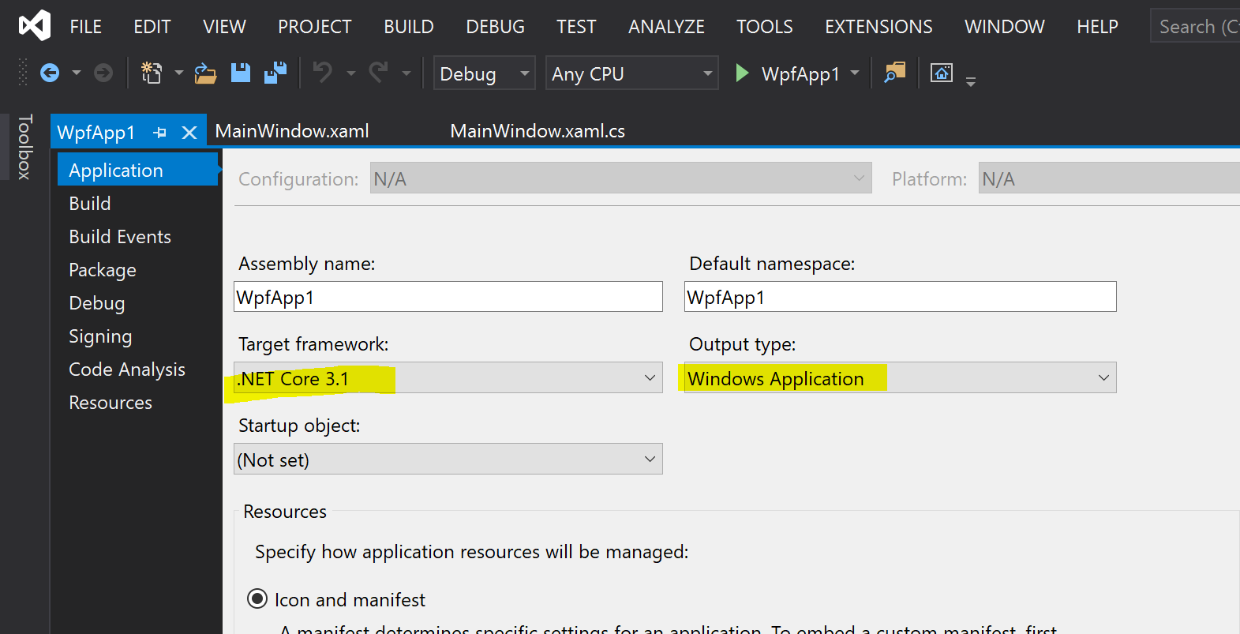

Why Windows Desktop on .NET Core?
Deployment Flexibility
Side-by-side support
Machine global or app local framework
Self-contained EXEs
Core runtime and API improvements
Performance
X
=

Slide 13
ASP.NET Core 3
www.asp.net
gRPC
High performance contract-based RPC services with .NET
Works across many languages and platforms
Worker Service
Starting point for long running back processes like Windows Server or Linux daemon
Producing or consuming messages from a message queue
Web API’s + Identity
Add security and authentication to Web API’s

Slide 14
ASP.NET Core 3 Blazor
www.blazor.net
Full stack web development with C#
You don’t need to know AngularJS, React, Vue, etc.
Take advantage of stability and consistency of .NET
Runs in all browsers
Strongly typed on the client and server
Share C# code with the client and server
Web Assembly (In Preview, Release in May 2020)
Native performance
Requires no plugin or code transpilation

Slide 15
Machine Learning with ML.NET
dot.net/ml
Built for .NET developers
Create custom ML models using C# or F# without having to leave the .NET ecosystem
Custom ML made easy with AutoML
Visual Studio Model Builder and CLI make it super easy to build custom ML Models
Extended with TensorFlow & more
Leverage other popular ML frameworks (TensorFlow, ONNX, and more)
Notes:
Support for new scenarios such as Sales Forecasting, Anomaly Detection
General availability of TensorFlow and ONNX support
Preview: Native database loader that enables training directly against relational databases
Preview: Build custom deep learning models using Tensorflow
Support .NET Core 3 - New scenarios in Model Builder - GitHub Issue classification
"and we're working on adding some cool stuff, which we'll show you an example of in the next demo" .. or something like that (because deep learning for Model Builder won't be released for a while)
few things you can do with ML.NET
Sentiment analysis
Customer segmentation
Product Recommendation
Price prediction
Fraud detection
Sales forecasting
Spam detection
Image classification

Slide 16
The .NET Roadmap
Many
.NETs
2014
.NET FRAMEWORK
.NET CORE
XAMARIN / MONO
Runtime
Runtime
Runtime
Base Class Library
Core Library
Mono Class Library
Notes:
2014 – .NET Framework, .NET Core, Xamarin / Mono
Three different frameworks, hard to share code across them

Slide 17
The .NET Roadmap
Many
.NETs
.NET
Standard
2014
2016
.NET FRAMEWORK
.NET CORE
XAMARIN / MONO
Runtime
Runtime
Runtime
Base Class Library
Core Library
Mono Class Library
.NET STANDARD
Notes:
2016 – Introduce .NET Standard - can write libraries that run on all the .NET’s.
While all .NET’s must implement the same API’s, their implementations are different. The Runtimes are different.

Slide 18
Introducing .NET 5
The .NET Roadmap
Many
.NETs
.NET
Standard
.NET
2014
2016
Next
.NET FRAMEWORK
.NET CORE
.NET
XAMARIN / MONO
Runtime
Runtime
Runtime (JIT & Native)
Runtime
Core Library
Base Class Library
One Base Class Library
Mono Class Library
.NET STANDARD
Notes:
2019 – Introduce .NET 5 – Windows, Mac, Linux, Android, IOS all run .NET Core’s runtime
Same BCL used on all platforms, same runtime used on all platforms
Native code compilation on all platforms, by merging .NET Native and Mono AOT
JIT and AOT Runtime
.NET 5 is the next major version of the .NET Platform that brings technologies from .NET Framework, .NET Core and & Mono runtimes and frameworks together into one .NET platform.
.NET 5 will have one Base Class Library (BCL) that will contain APIs for building any type of application. All .NET workloads are supported with application frameworks including cross-platform web development with ASP.NET, iOS and Android mobile development with Xamarin, Windows Desktop, and cross-platform IoT.
.NET 5 will have both Just-in-Time (JIT) and Ahead-of-Time (AOT) compilation models for the multiple compute and device scenarios it must support. JIT has better performance for server and desktop workloads as well as development environments. AOT has better startup, a small footprint, and is required for mobile and IoT devices.
.NET 5 will also have one unified toolchain supported by new SDK project types, will have a flexible deployment model (Side-by-Side and self-contained EXEs) and continue .NET Core's superior performance for server & cloud workloads.

Slide 19
Introducing .NET 5 – A unified platform
TOOLS
DESKTOP
WEB
CLOUD
MOBILE
GAMING
IoT
AI
WPF
Windows Forms
UWP
ASP.NET
Azure
Xamarin
Unity
ARM32
ARM64
ML.NET
.NET for Apache Spark
VISUAL STUDIO
VISUAL STUDIO FOR MAC
.NET STANDARD
.NET 5
VISUAL STUDIO CODE
INFRASTRUCTURE
CLI
RUNTIME COMPONENTS
COMPILERS
LANGUAGES
Notes:
.NET 5 is the evolution of .NET Core, adding the best capabilities of Mono to provide support for small device footprints. .NET Core used the best parts of the .NET Framework as we built its initial release. .NET 5 takes the best of all of the learnings we have across our multiple implementations and brings them together into a single unified platform.

Slide 20
What is not in .NET 5?
Web Forms, WCF Server and Windows Workflow remain on .NET Framework 4.8 only. There are no plans to port these.
Recommendations
ASP.NET Blazor for ASP.NET Web Forms (we have a migration guide)
gRPC for WCF Server and Remoting (we have a migration guide)
Open Source Core Workflow for Windows Workflow (WF): https://github.com/UiPath/corewf

Slide 21
Future of .NET Framework?
.NET Framework 4.8 is the last major version of .NET Framework on Windows
Support policy remains the same:
Will always be in Windows
Will be patched with Windows
Will be supported with Windows
Keep existing applications on .NET Framework
Recommend .NET Core for new applications
>>>> .NET Core is the future
https://devblogs.microsoft.com/dotnet/net-core-is-the-future-of-net/
Notes:
As we add more and more workloads to .NET Core, and continue to innovate and focus on modern platform capabilities, we are at a point where we will be providing only critical updates to .NET Framework. This means that applications running on .NET Framework will continue to run the same as they always have. However, this also means that any new development should be with .NET Core moving forward.
New applications should be built on .NET Core. .NET Core is where future investments in .NET will happen. Existing applications are safe to remain on .NET Framework which will be supported. Existing applications that want to take advantage of the new features in .NET should consider moving to .NET Core

Slide 22
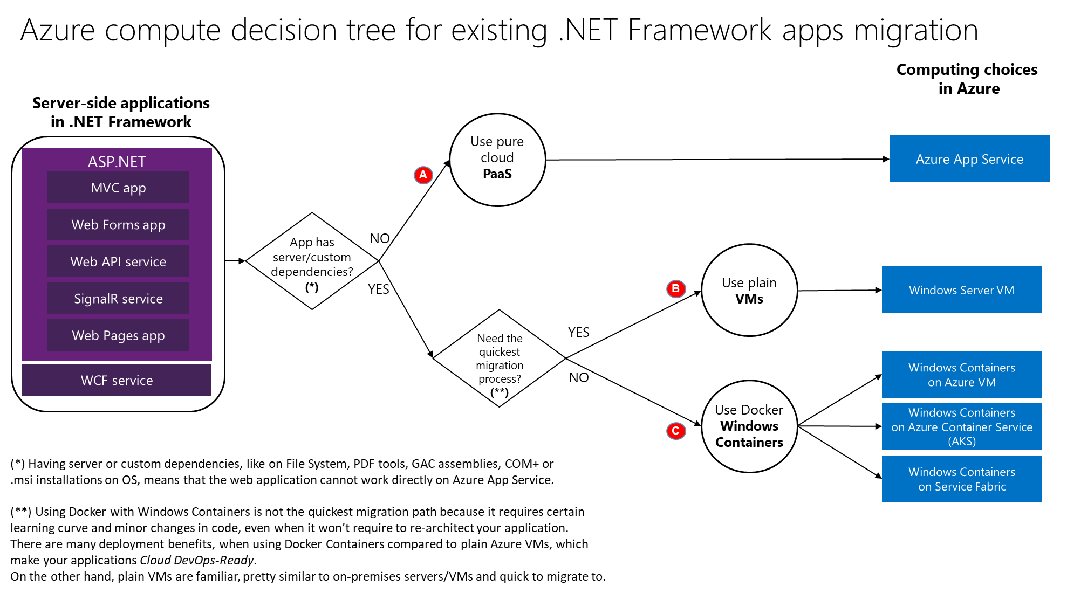

Slide 23










Azure is the best cloud for .NET
Azure Storage
Azure Cosmos DB
Azure App Service
Azure Functions
Azure App Insights
Azure Service Fabric
Azure SignalR Service
Azure Virtual Machines
Azure SQL Database
Azure Cognitive Services
Azure Kubernetes Service (AKS)
And many more…
Extend apps with serverless, event driven tasks
Commoditized AI
Fully managed platform perfect for running .NET Framework and .NET Core web aps and services
Application performance and usability monitoring
Build native .NET, fully managed, scalable microservices
Relational Database
Non-Relational Database
Fully managed real-time web functions, like chat, gaming, tickers, collaboration and more
Store anything. Great for binaries
Container orchestrator for Linux workloads (.NET Core)
Notes:
Azure is the .NET developer’s cloud. There are hundreds of developer services accessible to .NET developers. From fully managed platform as a service with App Service, to serverless event driven Azure functions to relational and non-relational databases, the .NET developer is a primary target customer. We make developing against these services as integrated and productive as a .NET developer would expect.

Slide 24








Azure Services Recommendations for .NET Apps
Azure Services
 | Azure Virtual Machines (VMs) | Azure App Service | Azure Kubernetes Service (AKS) | Azure Functions | Azure Batch | Azure Container Instances (ACI)
Web apps (Monolithic architecture)
N-Tier apps (Coarse-grain services)
Cloud-Native (Microservices architecture)
Batch / Jobs (Background tasks)
Recommended
Application
Architecture
Recommended
Large app portfolio Recommended
Recommended
Azure
event-driven
Recommended
Application’s
background tasks
Recommended
Large Batch scale
Recommended
Recommended
Possible
Notes:
As you look to modernize with .NET Core and microservice / serverless / event driven architectures, there are more options and recommendations. Here they are.
Service Sweet spots
Azure Container Instances
Run individual containers with no VM management
Azure App Service Web Apps
Deploy scalable web apps and services (with or without using containers)
Azure Kubernetes Service (AKS)
Use leading OSS orchestrator and associated CNCF tools to deploy and manage containers
Azure Batch
Schedule large scale batch processes deployed in containers

Slide 25
DEMO: Dapr state management and bindings
DEMO#1
Deploy a sample ASP.NET Core application to App Service
Notes:
This is a sample application that you can use to follow along with the Run a RESTful API with CORS in Azure App Service tutorial
languages:
- csharp
- aspx-csharp
page_type: sample
description: "This is a sample application that you can use to follow along with the Run a RESTful API with CORS in Azure App Service tutorial."
products:
- azure
- aspnet-core
- azure-app-service
---

Slide 26


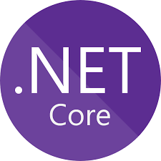









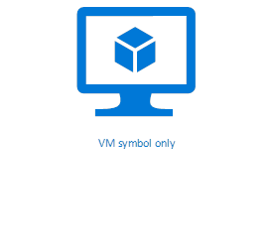






Maturity model for .NET application modernization
Existing apps
.NET web apps (on-premises)
Cloud
Infrastructure-Ready
Cloud-Optimized
PaaS
Cloud-Native
PaaS for microservices and serverless
Monolithic / N-Tier
architectures
Monolithic / N-Tier
architectures
Monolithic / N-Tier
architectures
Microservices and serverless architectures
Relational Database
IaaS
(Infrastructure as a Service)
Managed services
VMs
PaaS for containerized microservices
+ Serverless computing
+ Managed services
And Windows Containers
On-premises
Azure
Azure
Azure
Base Cloud Environment and cross-cutting concerns: Network, Hybrid-cloud, Identity/Auth, Cost control and Operations model
Migrate / Rehost
Modernize
Minimal code changes
Architected for the cloud, new code
Notes:
What’s next?
Modernize applications with .NET Core
Today we focused on Cloud-optimized .NET Framework apps. However, many applications will benefit from modern architecture built on .NET Core – a much faster, modular, cross-platform, open source .NET. Websites can be modernized with ASP.NET Core to bring in better security, compliance, and much better performance than ASP.NET on .NET Framework. .NET Core also provides code patterns for building resilient, high-performance microservices on Linux and Windows.

Slide 27
DEMO: Dapr state management and bindings
DEMO#2
Deploy a sample ASP.NET Core application to Azure Kubernetes Service (cloud native)

Slide 28
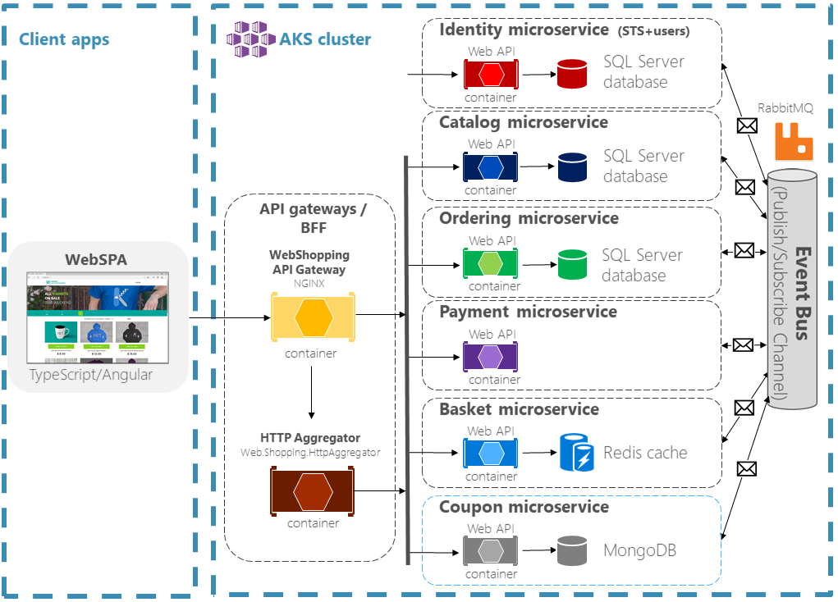
eShopOnContainers
Notes:
eShopOnContainers app is an online store that sells various products, including pins, T-shirts, suv-nir, and coffee mugs.
The store includes the following features:
Catalog management
Shopping basket
User management
Order management
Payments
The retailer uses a cloud-native, microservices-based architecture developed using .NET Core for its online storefront.
The catalog service stores its data in a SQL Server on Linux database. The basket service uses a Redis cache for storage, and so on. There's no single master data store with which all services interact. Instead, inter-service communication occurs on an as-needed basis, either via synchronous API calls or asynchronously through messaging.
This data isolation gives every service the autonomy to independently apply data schema updates without breaking other services in the production environment.
Asp.net core – angular SPA solution deployed as containers on AKS Linux cluster.
The microservices are accessible to clients via the API gateway. It enhance security and decouple back-end services from individual clients.
The WebSPA storefront is an ASP.NET Core MVC and Angular app that is accessible via a public IP address.
The HTTP requests from the WebSPA app to the microservices are routed through the API gateway, which is an implementation of the Backends-For-Frontends (BFF) pattern. Basic routing configurations are implemented using the NGINX reverse proxy. The ASP.NET Core web API named Web.Shopping.HttpAggregator combines multiple requests into a single request—a pattern known as Gateway Aggregation.
Let’s see the demo of how ASP.NET Core microservices running in Azure Kubernetes Service (AKS) in action.

Slide 29
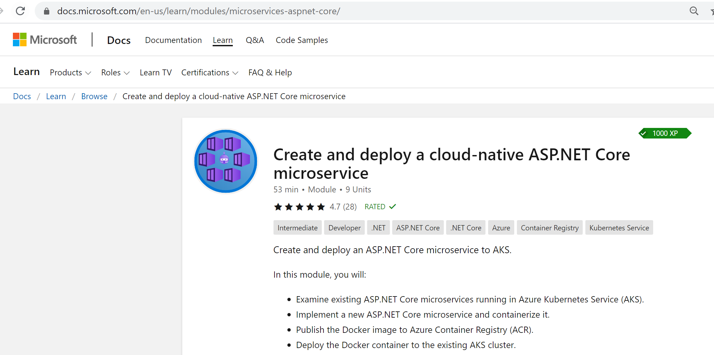
https://docs.microsoft.com/en-us/learn/modules/microservices-aspnet-core/

Slide 30
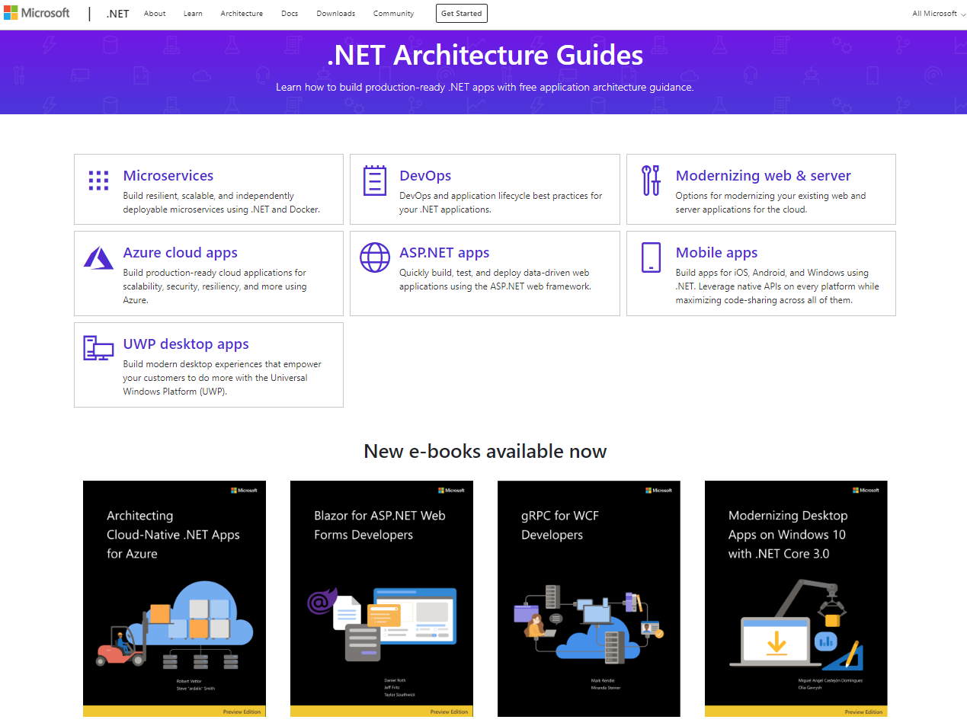
Thank you
www.dot.net/architecture
https://appmigration.microsoft.com/
maheskblr

